Slide 1
Trade Processing – An Introduction

Slide 2
Objectives On completion of this tutorial, you will be able to: - identify the roles of the key market players involved in the execution, clearing, and settlement of trades - recognize the typical organizational breakdown of a bank into front, middle, and back offices - explain the fundamentals of settlement and settlement instructions Tutorial Overview To some people, the whole area of trade processing represents the less glamorous side of the securities industry. However, without the efficient management of a trade throughout its lifecycle, the trade would be pointless in the first place. The risks to an organization from failed settlement can be considerable; these range from regulatory fines to interest charged on funding deficits. More serious consequences can also arise from poor procedures and controls in relation to operational activities, as evidenced by the failure to uncover rogue trading activity at Barings, Allfirst and, more recently, National Australia Bank. This tutorial covers the fundamentals of trade processing, looking at the main market participants and their roles, the functions of the front, middle and back offices, and introducing some key concepts in relation to the settlement of trades.

Slide 3
Market Participants

Slide 4
Securities Market – Key Participants
The key participants in the securities markets are as follows:
Investors
Agents
Banks
Broker/dealers
Exchanges
Regulators
Clearing houses
Custodians

Slide 5
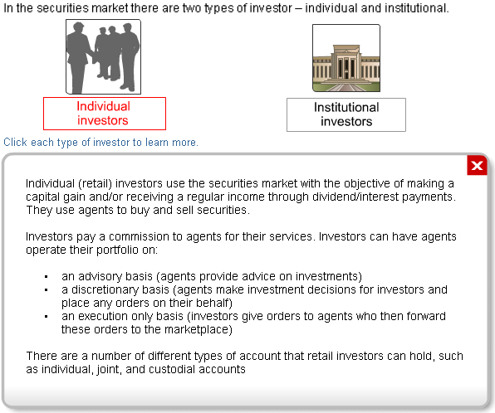
Investors

Slide 6
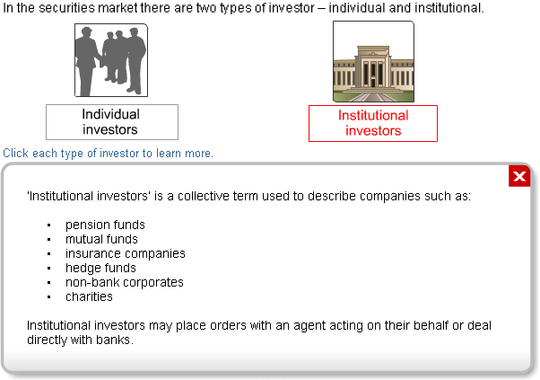
Contd..

Slide 7
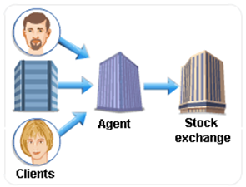
Agents
Agents act as brokers/intermediaries by buying and selling securities on behalf of their clients. As explained earlier, agents can act in various capacities. Agents make money by charging a commission for executing a client order. They are not permitted to charge a mark-up on prices quoted by third parties, such as market makers and traders, in the market. Commission charges may vary depending on the client. For instance, lower charges may be applied to institutional trades, as the average size of such trades is generally much larger than that of retail investor trades. Agents may also provide custodial services to their clients for a fee.

Slide 8

Banks
Banks are market makers/traders who operate in the market by buying securities from, or selling securities to investors, agents, or other banks. Banks make profits from the bid-offer spread – the difference between the purchase price of a security and the sale price of the same security.
The key difference between market makers and traders is that market makers publicize the securities prices at which they are willing to trade, while traders may be representing clients' orders and negotiating terms with market makers or trading for their own account and risk. Traders may decide to trade only in certain securities, or not to trade at the price at which a potential counterparty is willing to trade.
It is worth noting that in some countries banks perform the functions of custodians, advisors, market makers, and trade execution, whereas in other countries banks only perform the role of custodians and advisors. For simplicity, we will use the term 'banks' to denote both banks and broker/dealers unless otherwise specified.

Slide 9
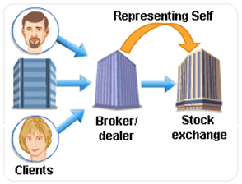
Brokers/Dealers
A broker/dealer firm operates in a dual capacity in the securities marketplace. It acts as a broker (agent) advising and representing clients in the market. The broker/dealer also acts as a principal, making markets, trading against its own clients and other market participants, as well as trading for its own account.

Slide 10

Exchanges
Securities are bought and sold in the marketplace. Much of this trading occurs on exchanges. Contrary to the clichéd image many people have of stock exchanges, not all exchanges have physical trading floors with traders running around, yelling and signaling to each other. Trading on many exchanges now takes place electronically through sophisticated computerized systems. Furthermore, stocks (equities) are not the only instruments traded on exchanges – many bonds and derivative instruments, such as futures and options, are also exchange-traded.

Slide 11

Regulators
Regulatory authorities ensure that transactions in the securities markets are undertaken in a manner that ensures the protection of investors and that maintains fair, orderly, and efficient markets.
The work of regulators includes:
assessing the suitability of various market participants to carry out their business
promoting the disclosure of important market-related information
monitoring the business undertaken by banks and other market participants
monitoring transactions for evidence of insider trading, fraud, or other malpractice
enforcement of legislation and industry practices

Slide 12
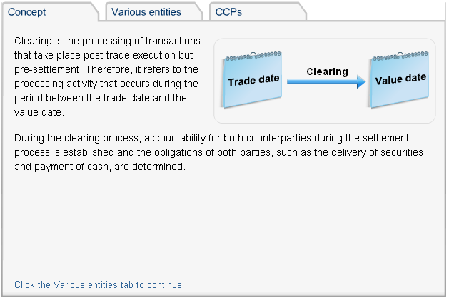
Clearing Houses

Slide 13
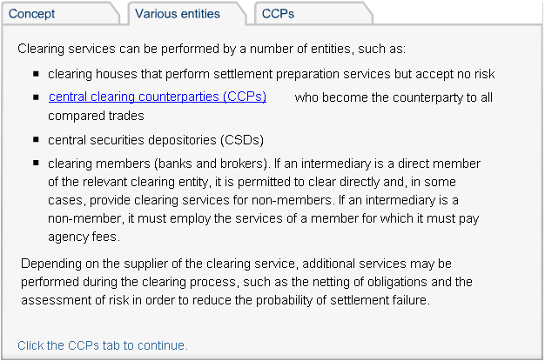
Contd..

Slide 14
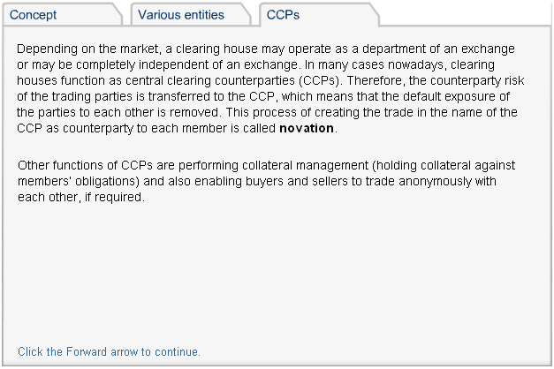
Contd..

Slide 15
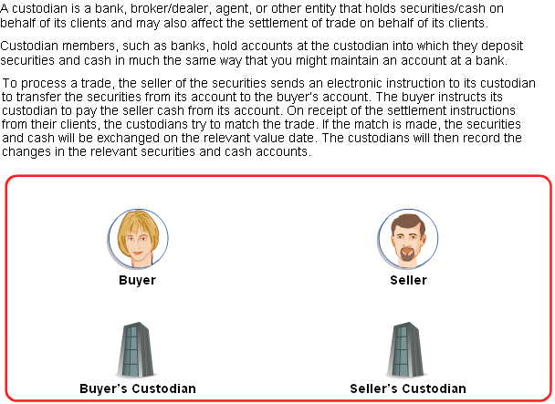
Custodians

Slide 16
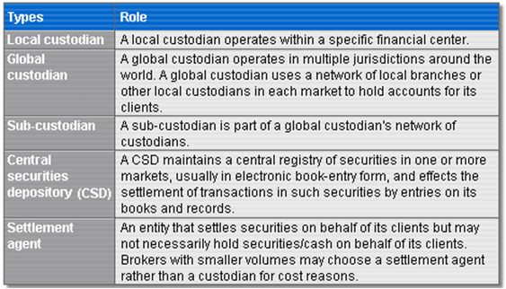
Types of Custodians
In many ways, the term 'custodian' is a generic term covering a number of different entities involved in the provision of custodial/settlement services.

Slide 17
Contd..
The role of CSDs is worthy of further explanation. These entities include:
National Central Securities Depositories (NCSDs)
International Central Securities Depositories (ICSDs)

Slide 18

National Central Securities Depositories (NCSDs)
An NCSD is typically established and operated on behalf of a national stock exchange as the central depository for securities traded and settled in that jurisdiction. Membership of NCSDs is open to banks, custodians, fund managers, brokers, and other forms of intermediaries. In some cases, foreign entities may not be permitted to become direct members of an NCSD and may need to utilize the services of a 'sponsor'.
Examples of NCSDs include:
Euroclear UK and Ireland (formerly CRESTCo), the CSD for the UK and Ireland http://www.euroclear.co.uk
Depository Trust Company (DTC), the CSD for the US http://www.dtc.org
Clearstream Banking, the CSD for Germany and Luxembourg http://deutsche-boerse.com
JASDEC, the CSD for Japan http://www.jasdec.com/en/index.html
The word 'central' sometimes leads to the misunderstanding that there is only one CSD in a country, while in practice there may be more than one. However, there is a trend to centralize securities clearance and settlement activities of a country in a single CSD.

Slide 19
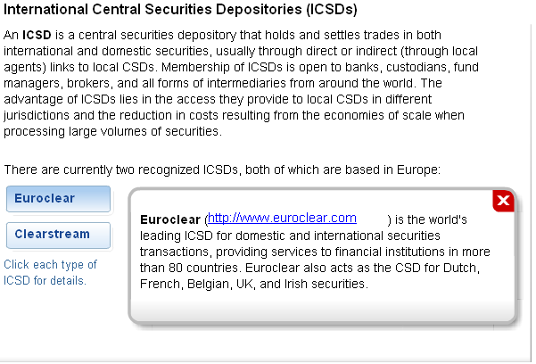

Slide 20
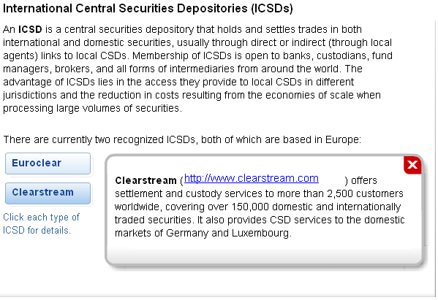

Slide 21
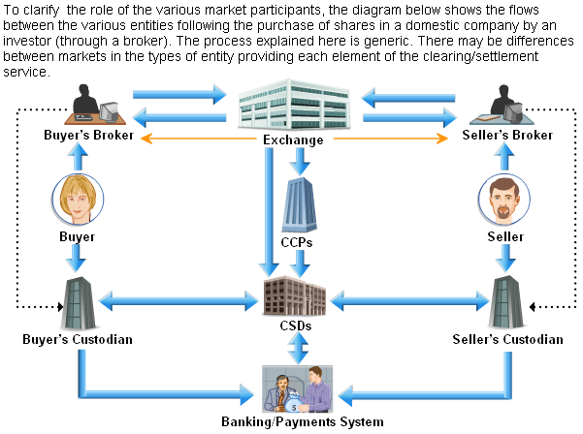
Flow of Instructions for Trade Clearing and Settlement

Slide 22
Typical Bank Organizational Structure

Slide 23
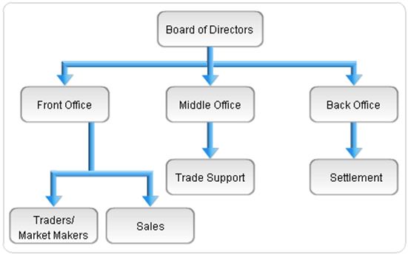
Typical Organizational Structure
Although no two banks are structured identically, it is important to present a typical organizational structure in order to aid understanding of the trade processing function.
Banks are frequently structured into front, middle, and back offices. The responsibilities of each area will vary from one institution to another. However, a typical organizational structure might look as shown in figure. There are also a number of other departments, such as compliance, internal audit, IT, finance, and risk management, that carry out their duties across all areas of the bank and, therefore, operate independently of the divisions represented above.

Slide 24

Role of the Front Office
The more client-facing side of the business is known as the front office. These personnel typically include:
sales people (also known as client or account managers), who act as the main contact point between the bank and its clients
traders/market makers, who are responsible for executing trades with various counterparties
Trading desk personnel typically have direct contact with interbank counterparties and quote prices directly to these counterparties. Corporates and individuals access the markets through the sales desk, which in turn asks the traders for quotes for these clients.
Brokers who act on behalf of clients by executing orders against other brokers or market makers can also be regarded as part of the front office activity.

Slide 25
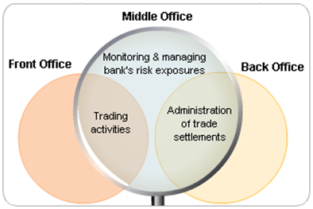
Role of the Middle Office
The middle office is a trade support function with the key responsibility of monitoring and managing a bank's risk exposures. To carry out this responsibility, the middle office liaises closely with both the front office, which is responsible for trading activity, and the back office, which handles the administrative aspects associated with trade settlement.
Tasks for middle office staff vary from one bank to another but typical duties include:
initial trade verification
the input of trades into relevant trading systems (on behalf of traders)
investigation of any discrepancies in trade details
daily P&L reporting
reconciliation and updating of trading positions
monitoring risk limits
The middle office function is designed to provide a unified front-to-back office experience by bridging the gap between the front office, which often trades and manages complex financial products, and the back office, which is responsible for processing and settling these trades. The middle office typically gets involved in the risk management and control aspects of trading and is staffed by personnel who are capable of independently valuing portfolios and analyzing risk positions.

Slide 26

Role of the Back Office
Once a trade has been executed by a front office trader and recorded within the relevant trading system, the details of the trade are fed through to the back office or operations area.
The back office is the area of a bank that looks after most of the administrative side of any trades undertaken by the front office. Therefore, it is responsible for the accurate and timely settlement of all transactions in accordance with trade deadlines.
In performing its role, the operations area has a major responsibility to control operations risk, which is the risk of loss due to day-to-day operating errors and/or fraudulent activities. The back office should be the area where errors are detected and brought to the attention of dealers and management.
Some key responsibilities of back office employees include:
capturing trade details in the settlement system
validating trade details
issuing settlement instructions
ensuring that the trades settle on the value date
making payments by electronic transfer mechanisms and ensuring timely delivery of securities

Slide 27
Key Settlement Concepts

Slide 28
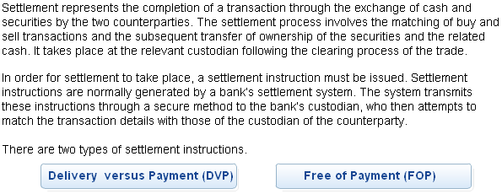
Settlement Instructions

Slide 29
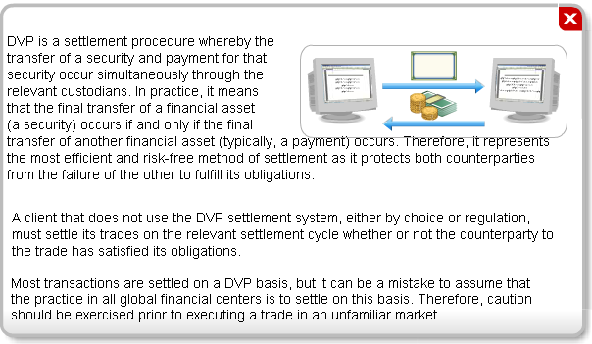
Delivery versus Payment (DVP)

Slide 30
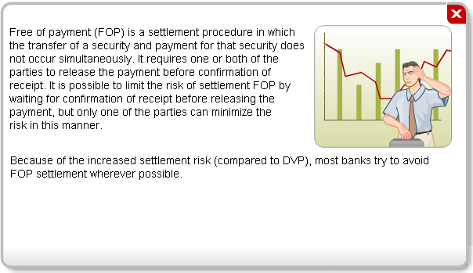
Free of Payment (FOP)

Slide 31
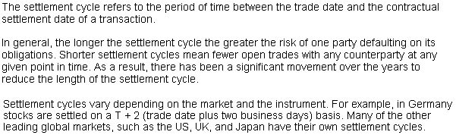
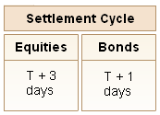
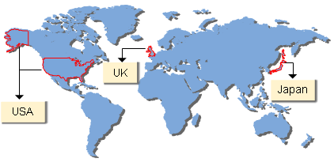
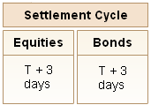
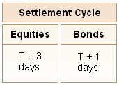
Settlement Cycles

Slide 32
Settlement Failure

Slide 33

Settlement Instruction Deadlines
It is the function of the operations area of a bank to effect accurate settlement of transactions in a timely manner. To prevent settlement failures and potential interest claims, this must be in accordance with trade deadlines.
Specific securities transactions adhere to different settlement cycles and deadlines for receipt of settlement instructions. Deadlines are set by the custodian, based on the cut-off times of the various clearing entities and depositories. The operations area of a bank is responsible for advising clients of the deadlines applicable to a transaction. Deadlines depend on the value date of a transaction but may also be affected by the method of transmitting settlement instructions.

Slide 34
Settlement Instruction Deadlines – Examples
Settlement of exchange-traded securities occurs on a T + 2 basis in Hong Kong. Therefore, a custodian in Hong Kong might impose a deadline of (say) 8 a.m. (Hong Kong time) on the value date for receipt of a settlement transaction – provided the instruction is transmitted in electronic format (such as SWIFT). However, if a bank in New York buys shares in a Hong Kong company, then the bank will need to issue the settlement instruction by close of business on a T + 1 basis (New York time) due to the time difference between New York and Hong Kong (New York is 13 hours behind).
Non-electronic transmission methods that require manual authentication are likely to have earlier deadlines. For example, tested telex requires the test key to be checked and the transfer of data from one system to another by a process of re-keying. Such a process is likely to increase the risk of error and delay.
Settlement instruction deadlines are set to maximize the chances of a trade settling on the value date. Custodians may still accept late instructions but such trades cannot be processed on the value date. To prevent such situations from occurring, settlement instructions should be transmitted as soon as possible following trade execution.

Slide 35
Standard Settlement Instructions
Standard settlement instructions (SSIs) are stable, long-term settlement instructions for a particular counterparty that are not subject to change on a trade-by-trade basis. With an SSI in place, there is no need for counterparties to advise one another on a trade-by-trade basis of the account number to which the transfer of securities/cash is to be effected.
Settlement instructions (SIs), on the other hand, are instructions that are subject to change on a trade-by-trade basis.
Where possible, SSIs should be exchanged between counterparties as a matter of best practice, particularly where there is no existing trading relationship (new client). Not only do they reduce the risks of settlement failure and fraud, but they also reduce trade processing costs and help to facilitate STP (straight through processing).
Ideally, SSIs should be communicated through authenticated or secure media, such as SWIFT. Any SSIs received through unauthenticated or insecure media, such as fax or e-mail, should be subject to a telephone call-back to verify the legitimacy of the instructions.

Slide 36
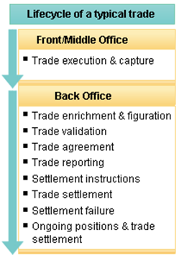
Straight Through Processing (STP)
STP is the term used in the securities industry to describe the objective of end-to-end automation of the pre-trade to post-trade settlement process. It involves the processing of information from the trade execution stage to the trade settlement stage without the need for re-keying or re-entering the same details into another system in order to complete the process.
Historically, there has been little connectivity between the various systems within many banks. As a result, significant manual intervention has been required to input the trade details at various junctures in the trade lifecycle. STP introduces the prospect that the details of individual trades are inputted only once following trade execution, with the system then managing the clearing/settlement process in a fully automated manner.
The process of implementing STP is still evolving. Institutions that embrace it are likely to see significant gains in operational efficiencies, while the securities industry as a whole will benefit from the faster, more efficient handling of trades than had previously been possible.

Slide 37

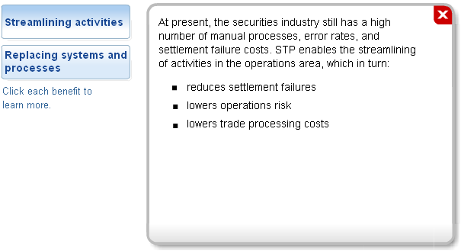
STP - Benefits

Slide 38
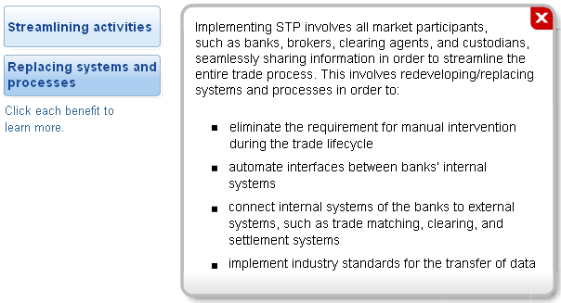
Contd..

Slide 39
Static Data in STP
The use of static (or standing) data is an important element in the move towards STP. This refers to additional or background data that is needed in order to process a trade, but is not directly related to the trade.
For example, in relation to counterparties, static data would include the counterparty’s full name, internal short name, location, contact details (telephone, e-mail), reference number, custodian names, and locations. In relation to securities, static data would include the security type (bond, equity, and so on), the ISIN (International Securities Identification Number) code, the default settlement cycle (T + 3, T + 2, and so on) and the settlement currency (GBP, USD, EUR, and so on).
Banks hold massive amounts of static data within their databases. The challenge for banks is initially to gather the data and store it, and then to utilize and update it appropriately. Despite the use of the term ‘static’, the data does change periodically, for example, if the settlement cycle in a particular market shortens.

Slide 40
Thank You

